Slide 1

PROJECT OVERVIEW
Title
Car Insurance Claim Prediction Model
Develop a predictive model that assesses the claim probability for car insurance policies. The objective would be to understand the factors that influence claim frequency and severity in the period of six months and enable insurance companies to better assess risk and determine appropriate premiums for policyholders.
Conducted By
Jagrati Paliwal
Data Science Batch

Slide 2
TOOLS
Programming Language
Framework
Python
Google Colab
-Issues with Anaconda packages

Slide 3
DATA SET
No. of Columns | 44
No. of Rows | 58592
Columns | 'policy_id', 'policy_tenure', 'age_of_car', 'age_of_policyholder', 'area_cluster', 'population_density', 'make', 'segment', 'model', 'fuel_type', 'max_torque', 'max_power', 'engine_type', 'airbags', 'is_esc', 'is_adjustable_steering', 'is_tpms', 'is_parking_sensors', 'is_parking_camera', 'rear_brakes_type', 'displacement', 'cylinder', 'transmission_type', 'gear_box', 'steering_type', 'turning_radius', 'length', 'width', 'height', 'gross_weight', 'is_front_fog_lights', 'is_rear_window_wiper', 'is_rear_window_washer', 'is_rear_window_defogger', 'is_brake_assist', 'is_power_door_locks', 'is_central_locking', 'is_power_steering', 'is_driver_seat_height_adjustable', 'is_day_night_rear_view_mirror', 'is_ecw', 'is_speed_alert', 'ncap_rating', 'is_claim']
Target Column | is_claim
Customers
Products
Categories
shippers

Slide 4
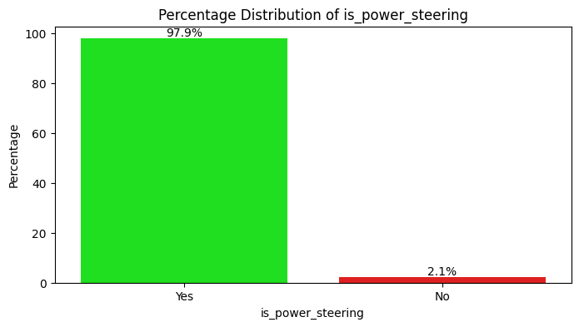
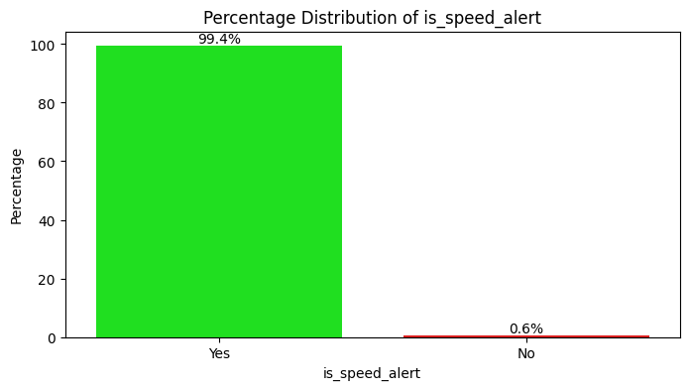
Data Analysis and Transformations
Policy ID
Unique
No Pattern
Deleting as unique value , no Pattern
Null Values/ Columns:
No Missing/null Values
Changing Year to month
Age_of_car (Range 0-1yrs)
Age _of Policy_holder (0-1yrs)
Policy tenure (0 - 1.39 yrss
Encoding Age of car and Policy holder in range of 6+months, 6_ months
Binary Data Columns Identified
Value - Yes, No
Converting these to Numerical
Deleting Columns with no pattern
* Data can be splitted on basis of Fuel Type
(Not adopted this approach)

Slide 5
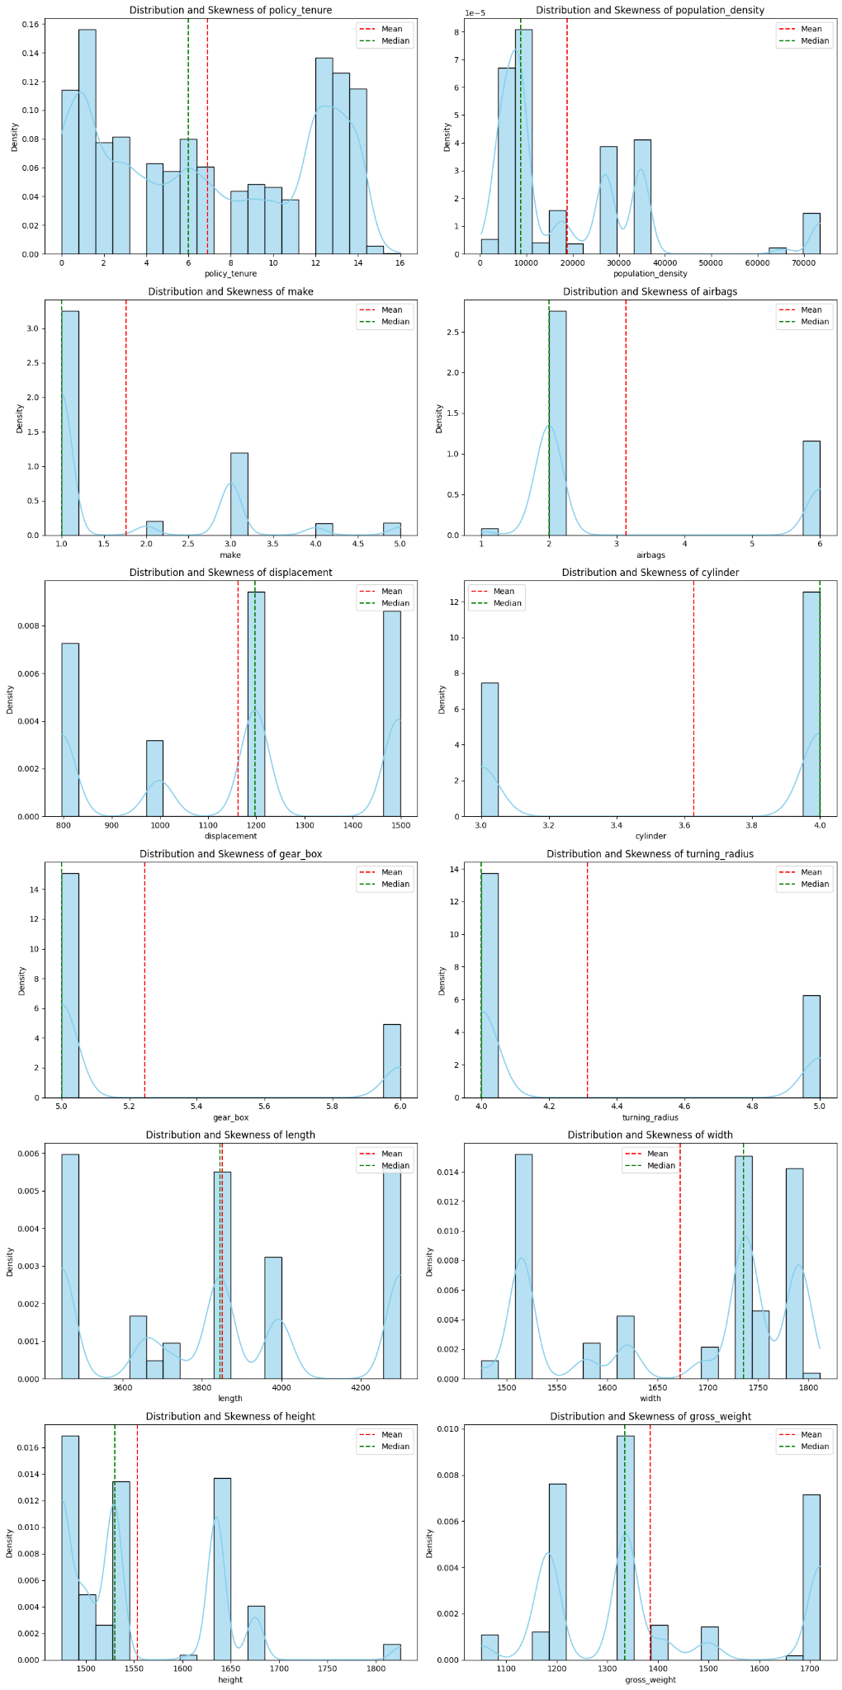
Exploratory Data Analysis
Skewness
columns with major Skewness
Treated with cube root transformation

Slide 6
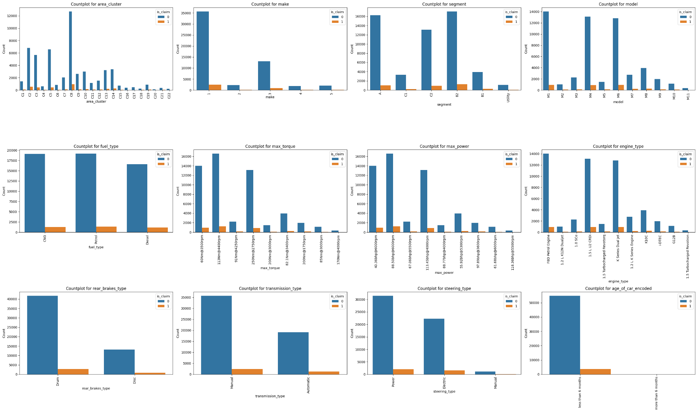
Countplots
Major Observation:
From C8 area cluster claim is grater in comarison to other clusters
MAke 1 Category posses high claims
Segment B2 shows high claim
Model 4 posses high claim
113#nm torque posses high claims
max power 88.50bph posses high claim
Drum BRakes cars tend s to file high claim
Manual transmission cars tends to file high claims
Power steering cars file high claim
Cars aging less than 6 month tends to file claim
Just after taking policy within 6 months more claims are filed

Slide 7
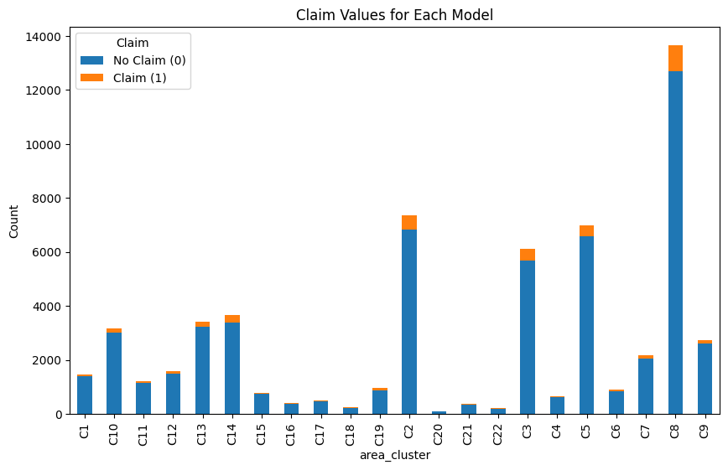
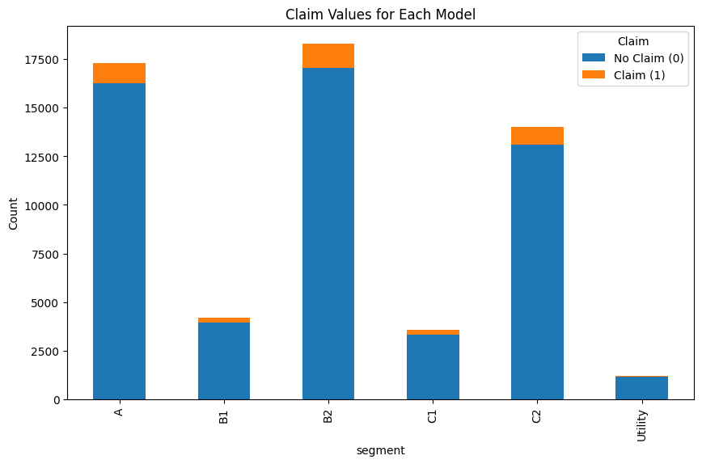
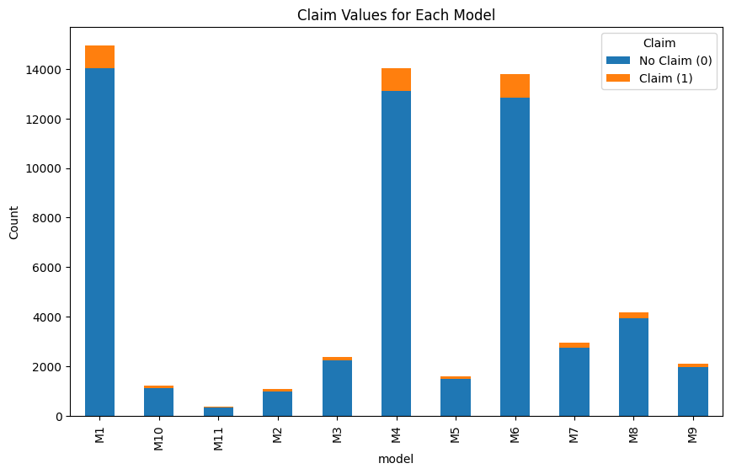
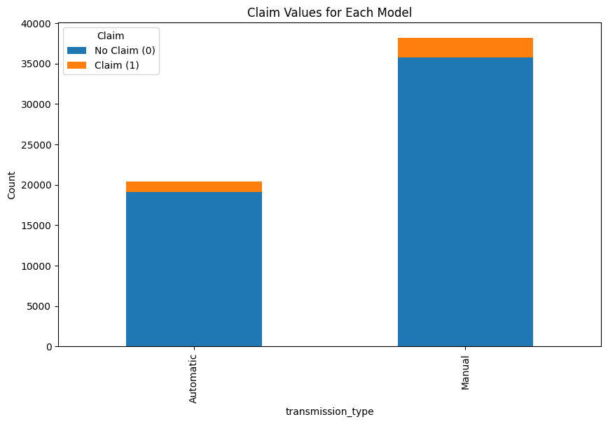

Slide 8
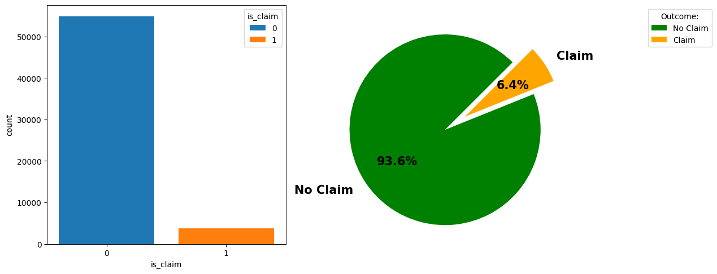
Exploring Target Column

Slide 9
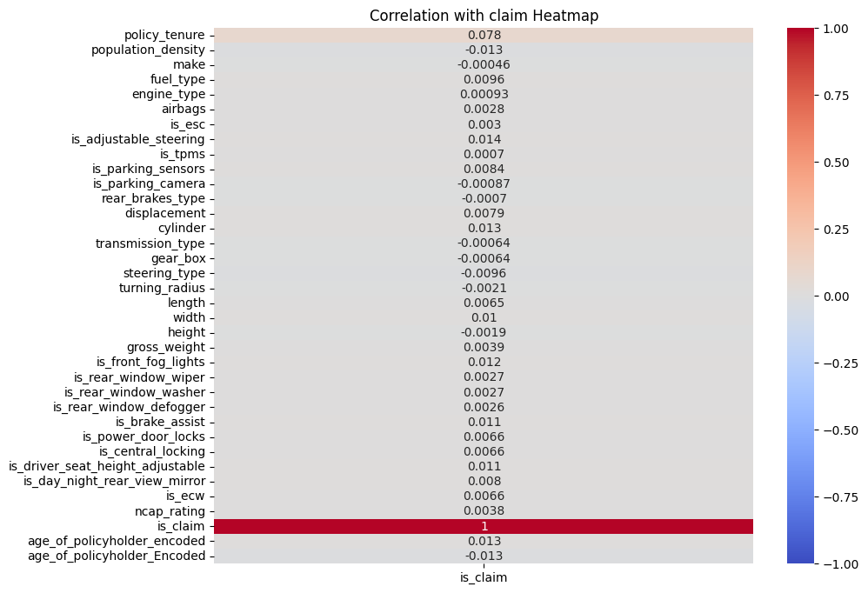
Correlation Analysis
From All Features
policy_tenure = 0.078461
is_adjustable_steering 0.013917
cylinder 0.013434

Slide 10
Model Training
Feature Engineering: RFE Approach
CLassifier: Random Forest Classifier
precision recall f1-score support
0 0.94 1.00 0.97 41133
1 0.88 0.04 0.07 2811
accuracy 0.94 43944
macro avg 0.91 0.52 0.52 43944
weighted avg 0.93 0.94 0.91 43944
precision recall f1-score support
0 0.94 1.00 0.97 13711
1 0.12 0.01 0.01 937
accuracy 0.93 14648
macro avg 0.53 0.50 0.49 14648
weighted avg 0.88 0.93 0.90 14648
y _Train // y_pred_Train
y_Test // y_pred_Test

Slide 11


INSIGHTS
Major Observation:
C8 Area Cluster shows high claim area
Cars by [1] Manufacturer shows high Claim
Cars Insured under Segment B2 shows high claim and under utility shows least
Model 4 of Insured cars shows high claim and M11 shows no claim
Each fuel Type has equal amount of claims
Cars with Drum Brakes tend to file high claim
Manual transmission cars tends to file high claims than automatics transmission type cars
Power and Electric steering cars file high claim amd Manual steering type records no claim
Cars aging less than 6 month are filed for claim
Just after taking policy within 6 months more claims are filed
Policy Tenure has high impact in Claim probability, and policy tenure for active status is 4 - 12.5 months

Slide 12

THANK YOU

